Slide 1
War and Independence
Part 5-
The Fighting Continues

Slide 2
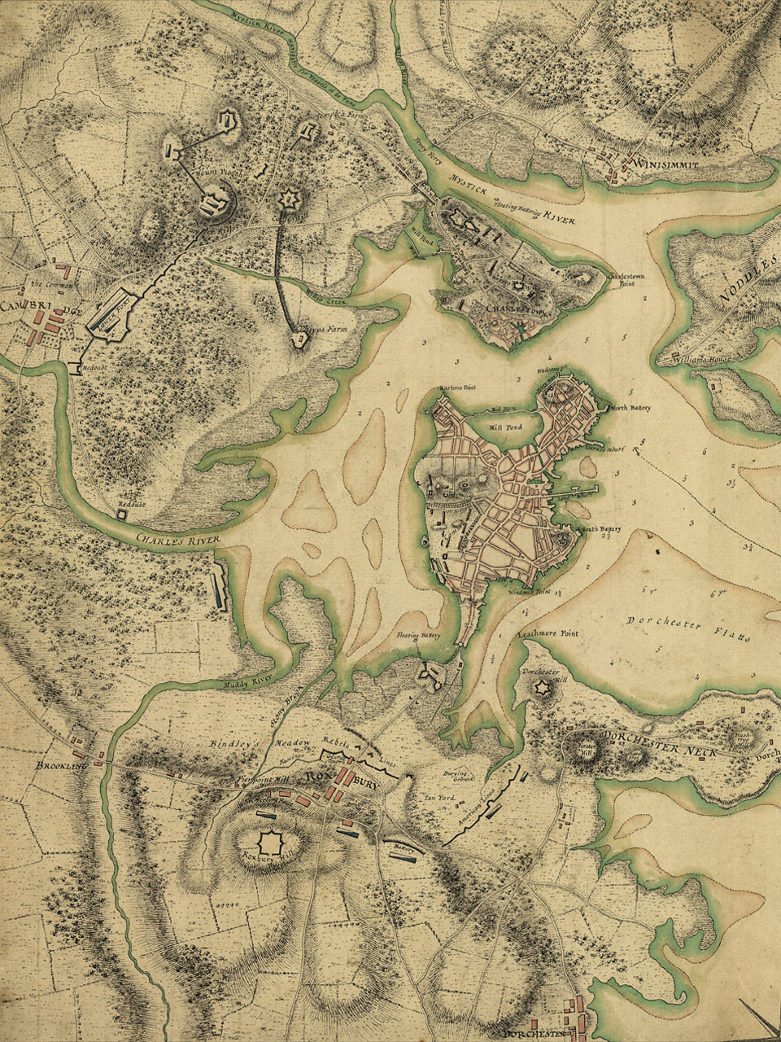
After the battles of Lexington and Concord, the British retreated back to the Boston area.

Slide 3
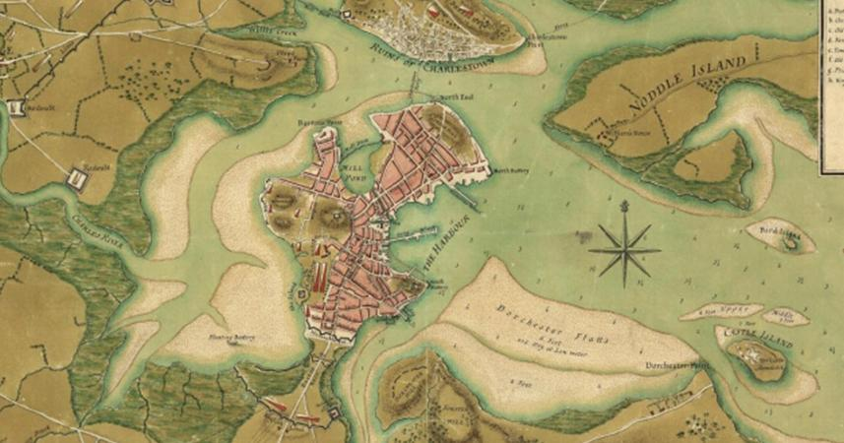
Over the next few weeks, over 20,000 militiamen from all over New England arrived in the Boston area. The British soldiers retreated to the city of Boston. The Siege of Boston lasted for the next eleven months.

Slide 4
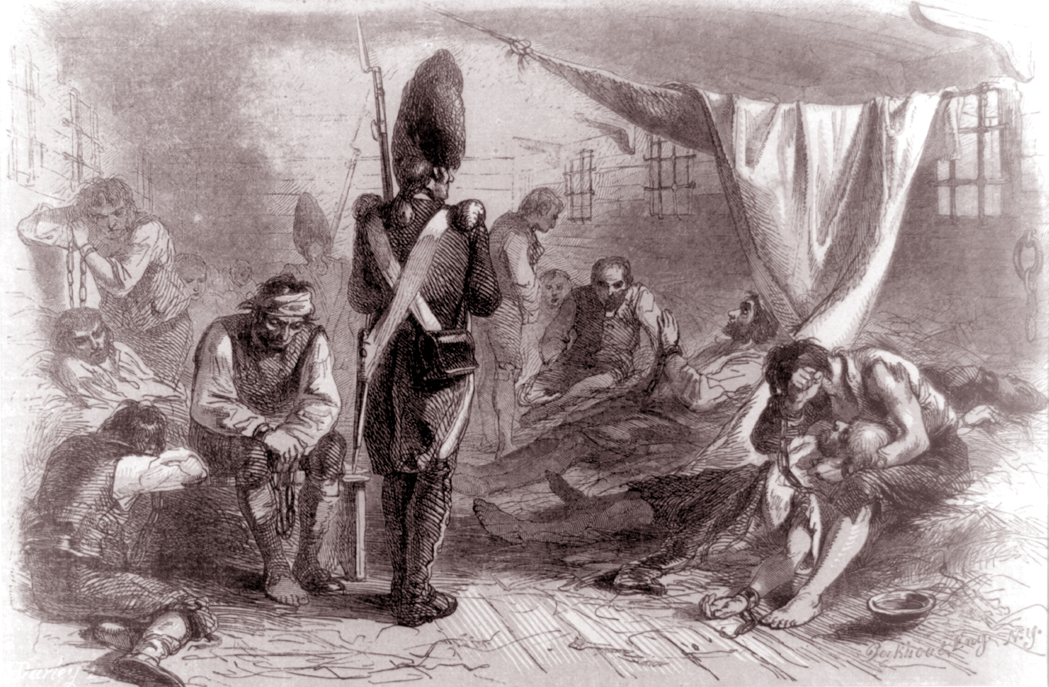
Many patriots fled Boston, while many loyalists from the surrounding area went into the city looking for protection from the British. Life during the siege was difficult. There were many shortages, including food.

Slide 5
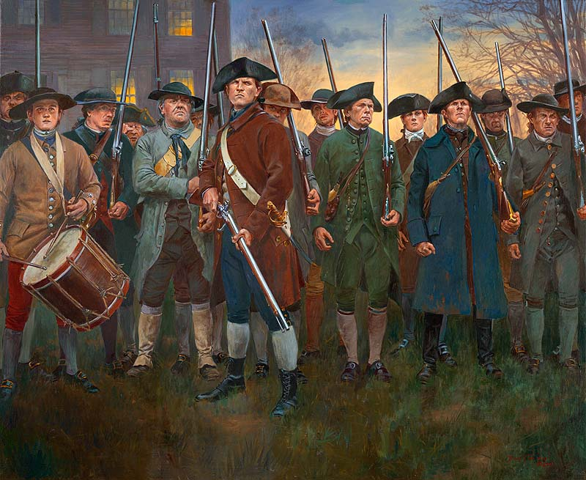
After Lexington and Concord, the situation for the patriots was confusing and chaotic at times. It took time to organize the militias into an army and determine who was in charge.

Slide 6
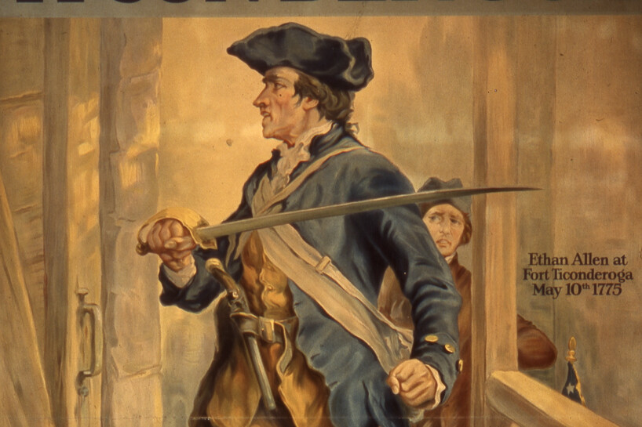
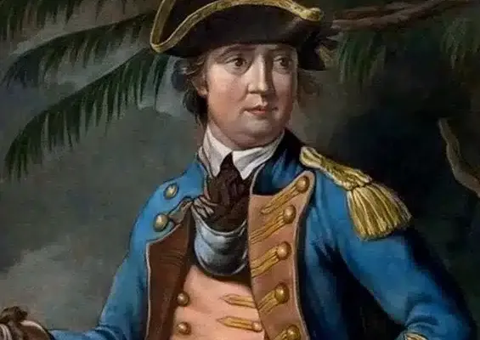
One example of this was in the taking of the British Fort Ticonderoga. Two patriots, Benedict Arnold and Ethan Allen (the leader of the militia group called the Green Mountain Boys) both had the idea of taking the British fort.

Slide 7
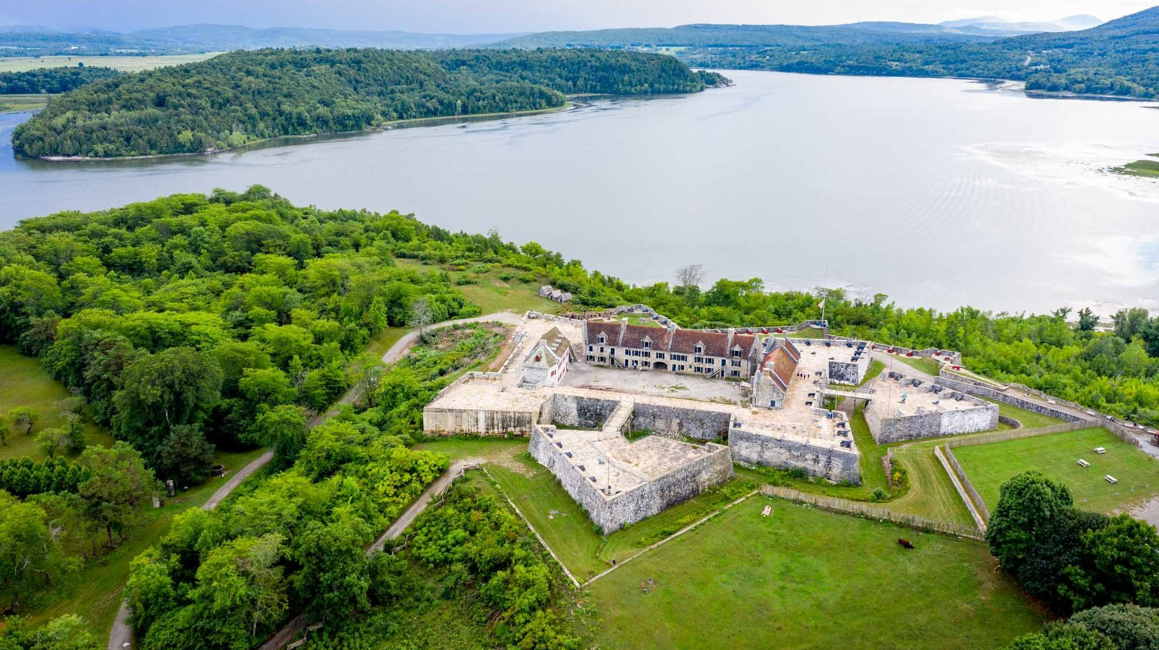
They ended up working together to take the fort, which had a valuable strategic location and lots of artillery (cannons) which the patriots would need in the war.

Slide 8
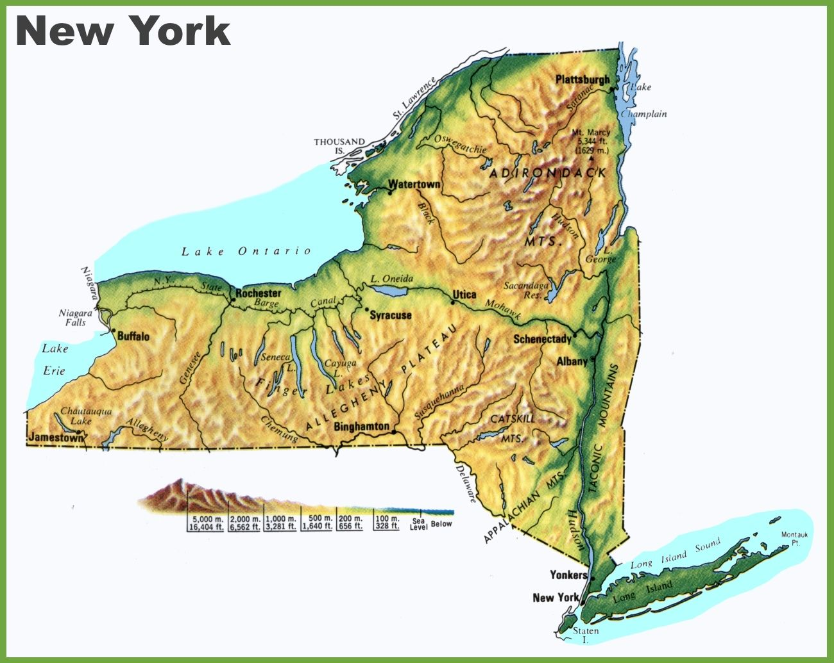

Slide 9
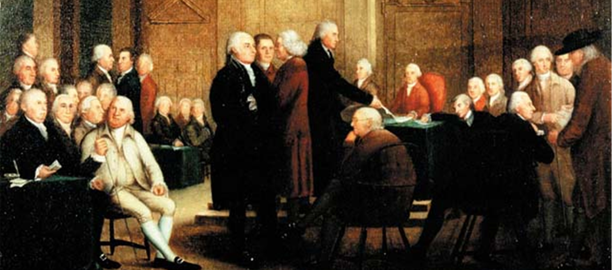
Because the situation between America and Britain was getting worse, the Continental Congress decided to meet again in May of 1775. This meeting became known as the Second Continental Congress. Eventually all 13 colonies sent delegates to the meeting.

Slide 10
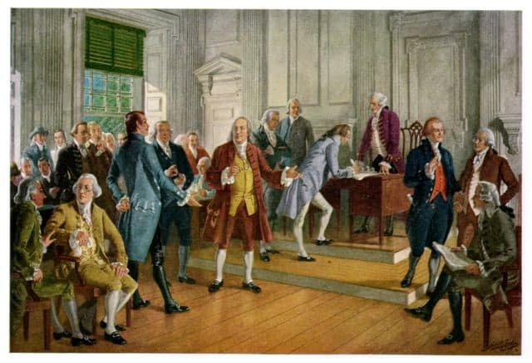
The Congress was again divided as to what to do. Some delegates thought war was the only option, while some still wanted to work out the problems with Britain peacefully.

Slide 11
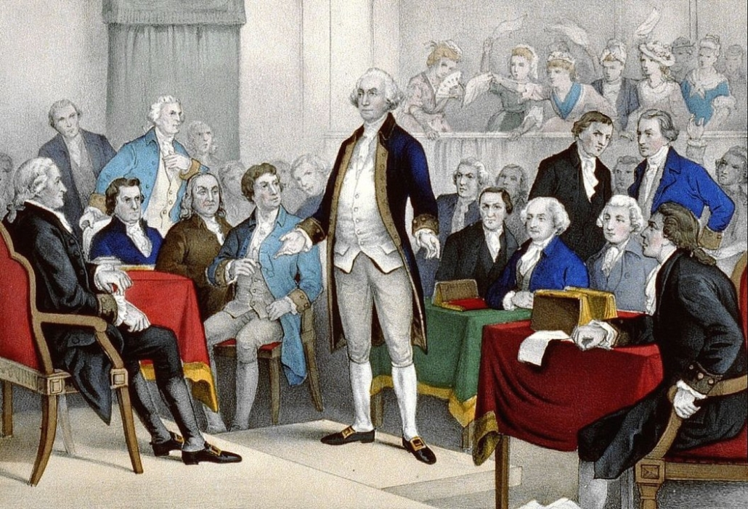
John Adams and others convinced the Congress to form a Continental army and make George Washington its leader. Washington soon left to take over the patriot militias outside of Boston.

Slide 12
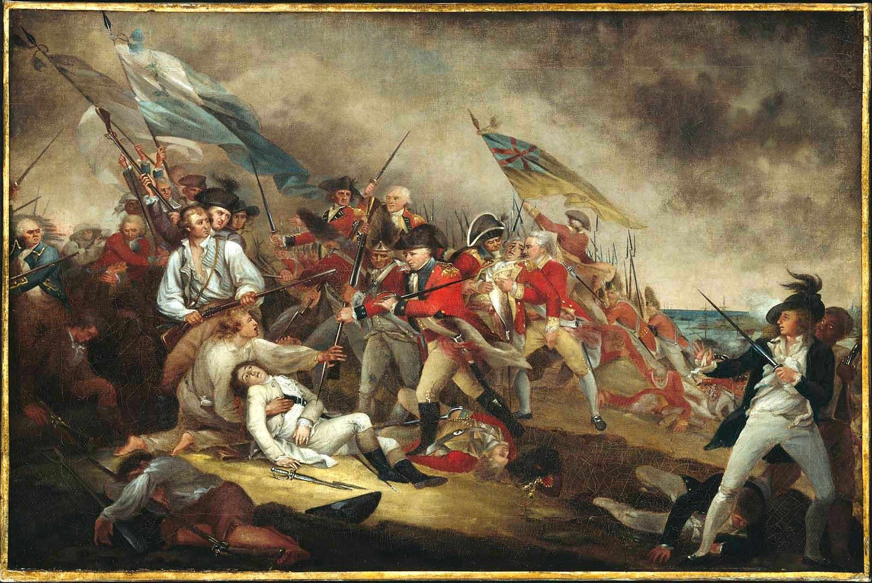
Before Washington made it to Boston, another battle took place on June 17, 1775. The Battle of Bunker Hill.

Slide 13
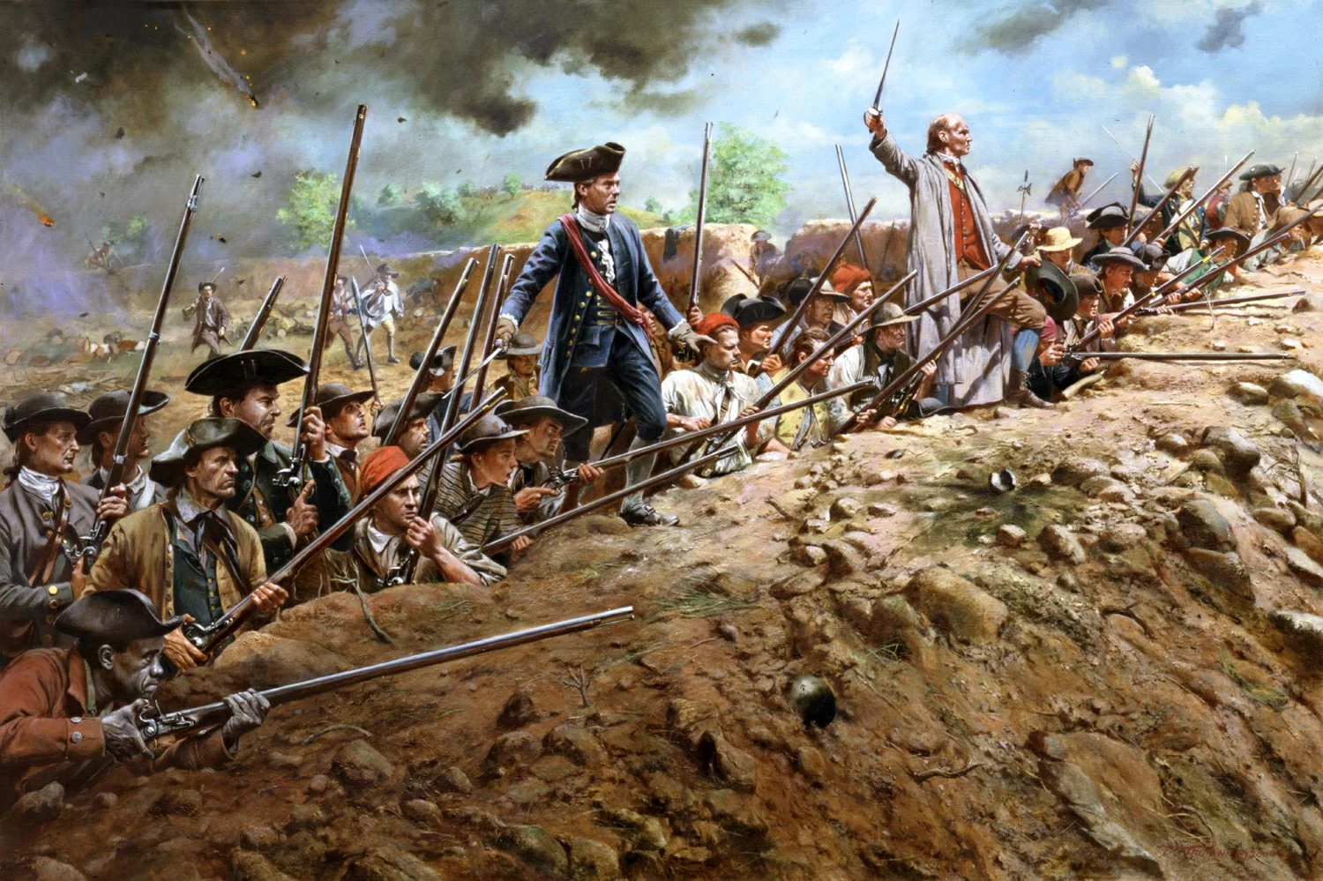

Slide 14
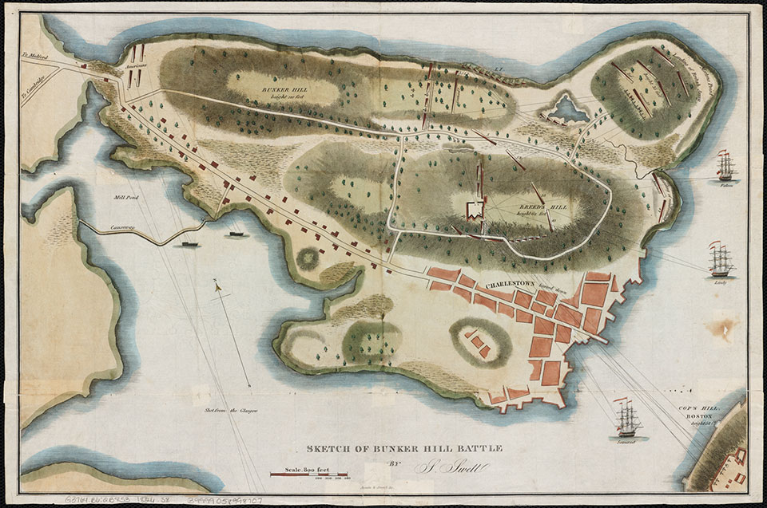

Slide 15
Think About It
Even though the Battle of Bunker Hill was a British victory, the battle lifted the spirits of the patriots, while it gave the British a sense of gloom. Why do you think that was?

Slide 16
When Washington finally arrived near Boston on July 2nd, he immediately got to work trying to organize the Continental army. He had to figure out how to feed and equip his men, provide for better sanitation in camp, and decide how to get the British out of Boston.

Slide 17
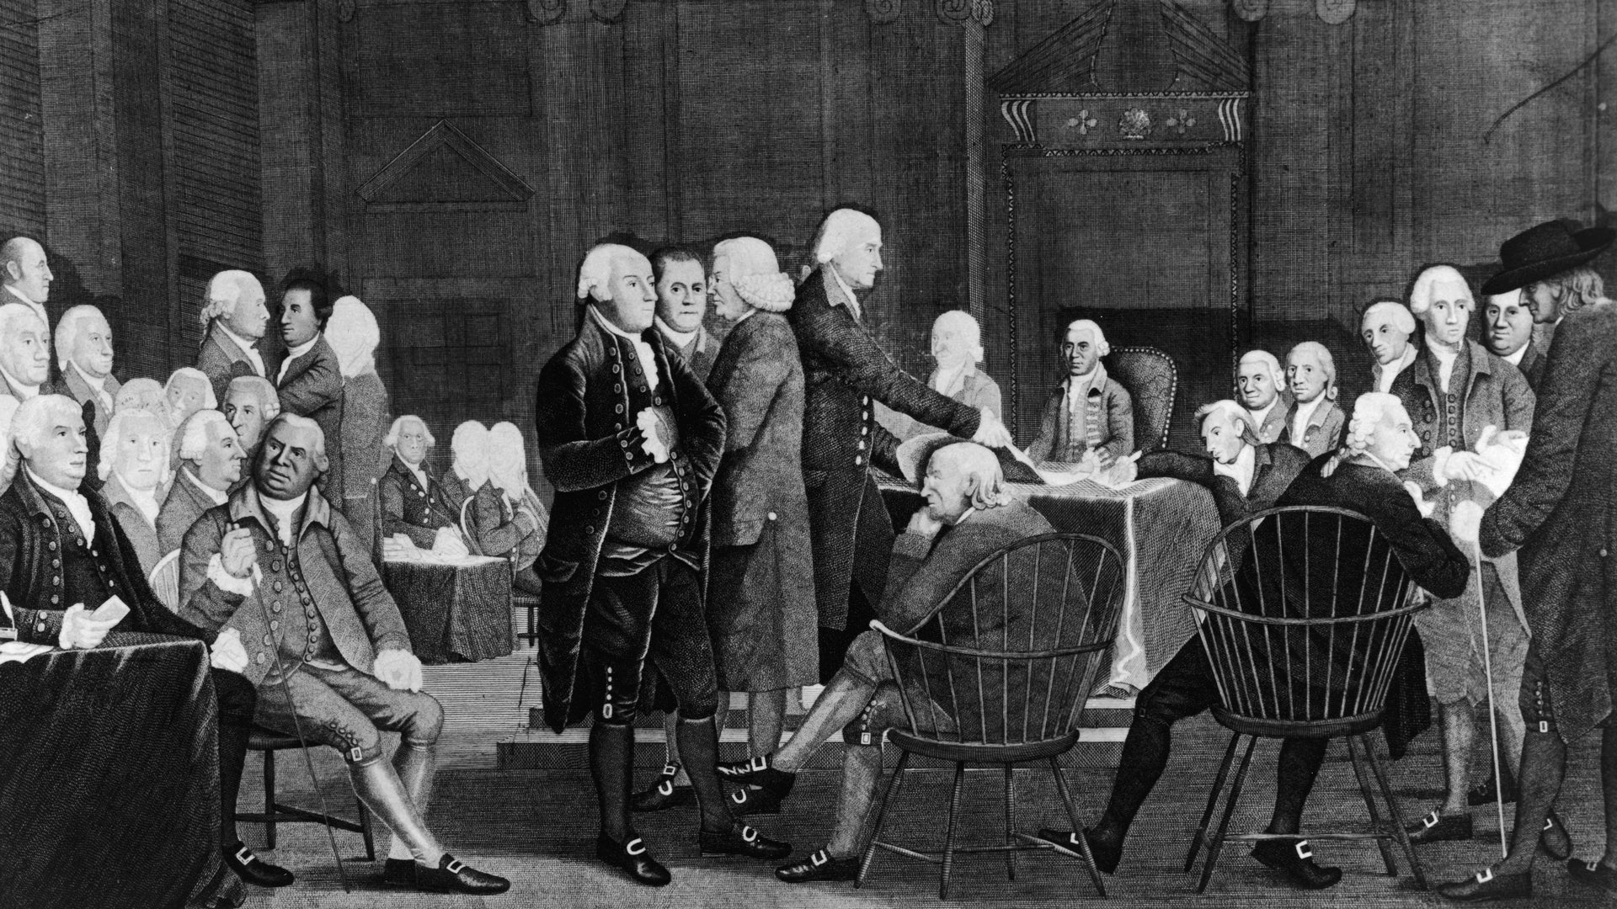
Back in Philadelphia, the Continental Congress continued to debate what to do. Most colonists still wanted peace even though several battles had been fought.

Slide 18

In July of 1775, the Continental Congress sent the king a letter they called the “Olive Branch Petition.” (An olive branch is a symbol of peace.) In the letter they blamed Parliament for the violence and asked the king to bring about “a happy and permanent reconciliation.” The king refused to even read it!

Slide 19
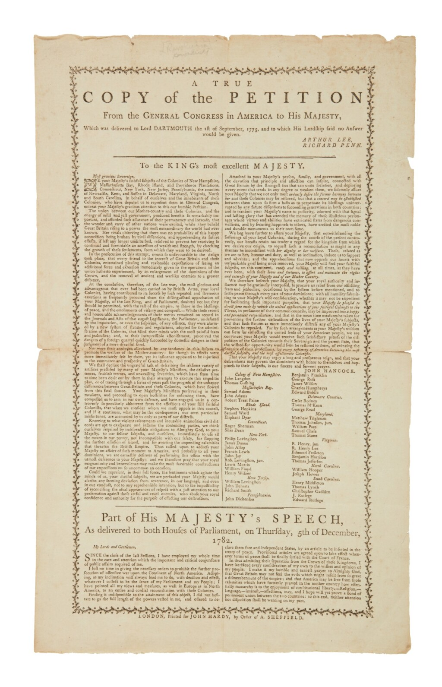

Slide 20
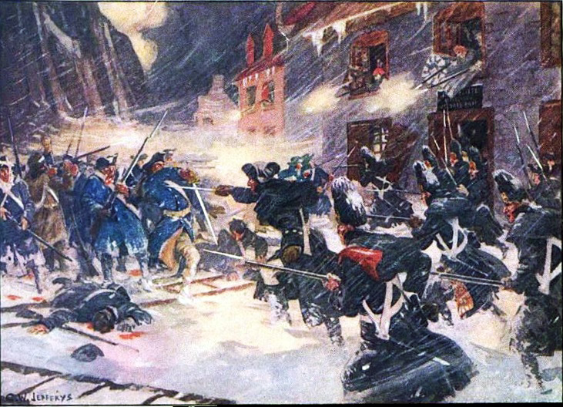
During the winter of 1775-1776, the Continentals sent an army to Canada to try to get the people of the province of Quebec to join the 13 colonies in rebellion against Britain. It eventually failed.

Slide 21
Exit Question
What do you think was the most difficult thing facing the Continental army as the war started? Why?

Slide 22
Extra History’s
Invasion of Quebec- Part 1
Extra History’s
Invasion of Quebec- Part 2

